Slide 1
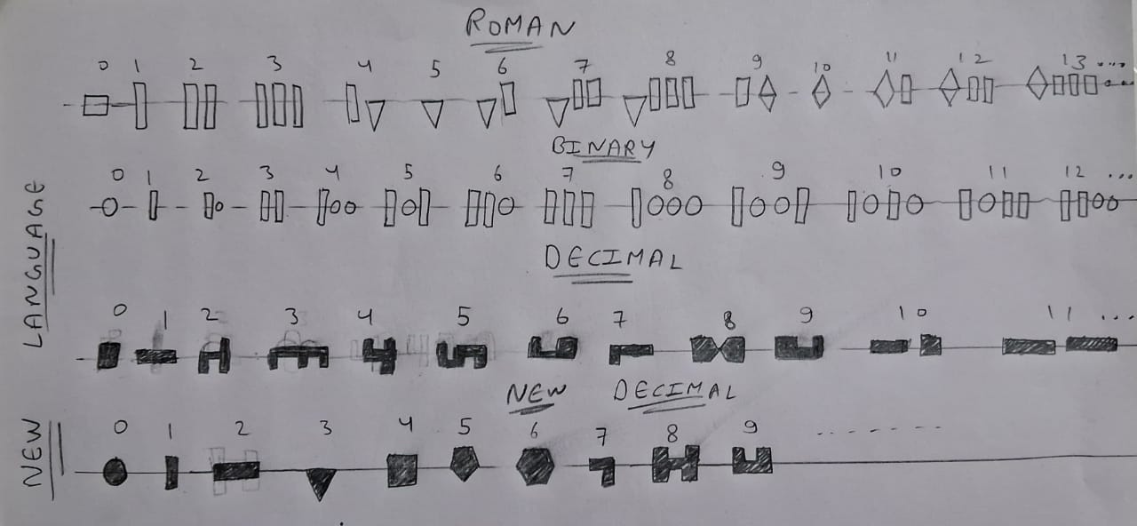
A Language For Universe TRUE SPACE SIGNAL

Slide 2
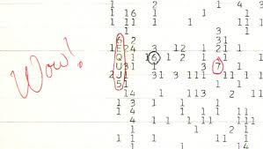
WOW signal
The Wow! Signal (August 15, 1977)
Detection:
Observed by Ohio State’s Big Ear radio telescope near Sagittarius
Frequency: ~1420 MHz (close to the hydrogen line)
Signal Details:
Duration: 72 seconds
Intensity noted as “6EQUJ5” (with “U” ~30× background noise)
Notable Moment:
Astronomer Jerry Ehman circled the signal and scribbled “Wow!” on the printout

Slide 3
Controversies & Theories
Controversies & Theories
Possible extraterrestrial transmission, but unconfirmed.
May be a rare astrophysical event (e.g., magnetar burst, hydrogen cloud collision).
Comet hypothesis proposed but widely disputed.
Earth-based interference? Unlikely due to protected frequency.
Decoding the Signal
“6EQUJ5” represents signal strength over time, not a hidden message.
The Real Truth
Never detected again → No definitive conclusion.
Could be alien or natural, but remains one of SETI’s biggest mysteries.

Slide 4
The IDEA
First – making a universal language, that can be trasmitted and received by any intelligent life form.
Second – Finding the ways to encode the universal language into a signal.
Third – deciding frequency of the signal(~1420MHz.).

Slide 5
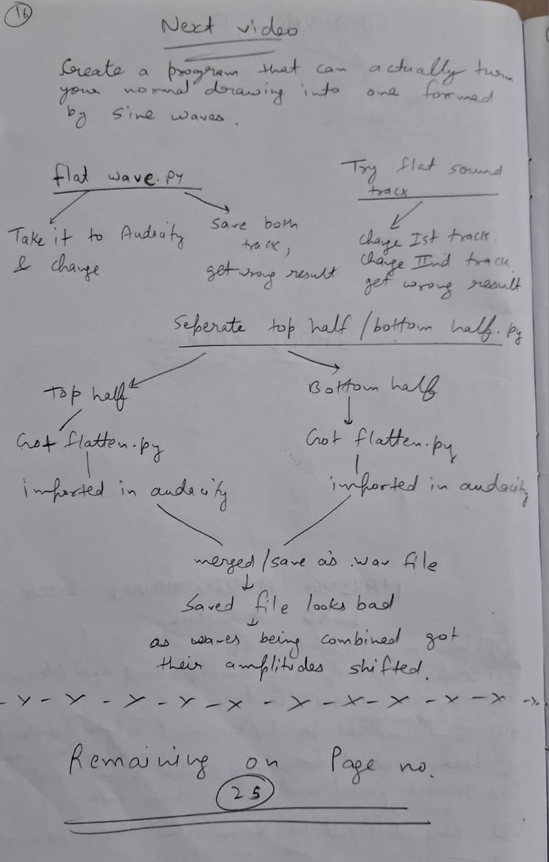
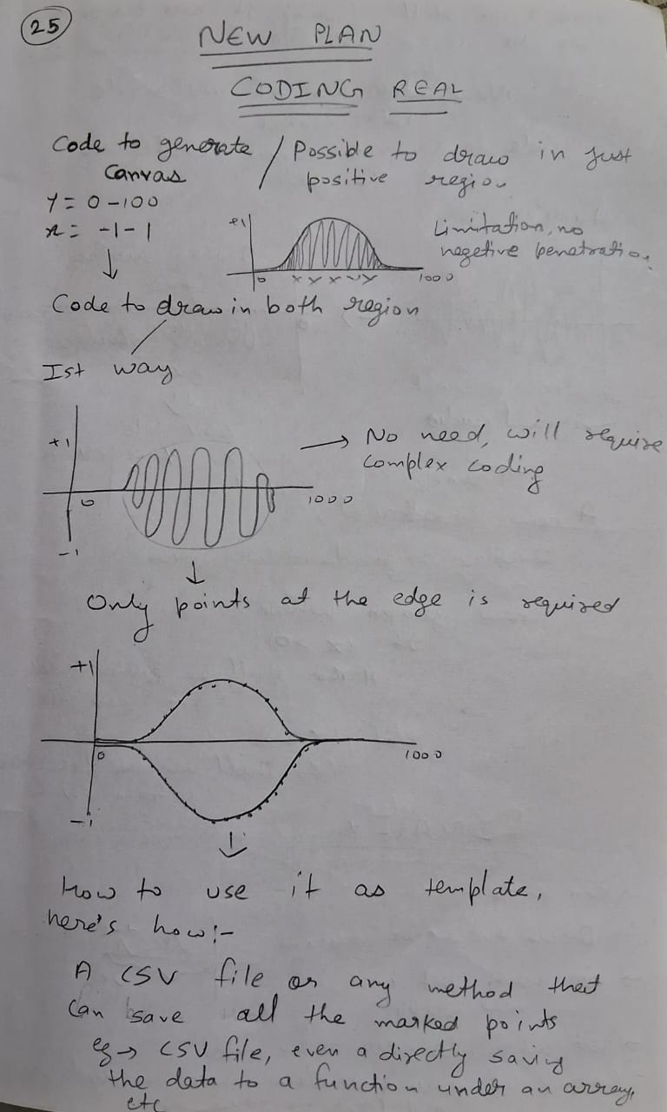
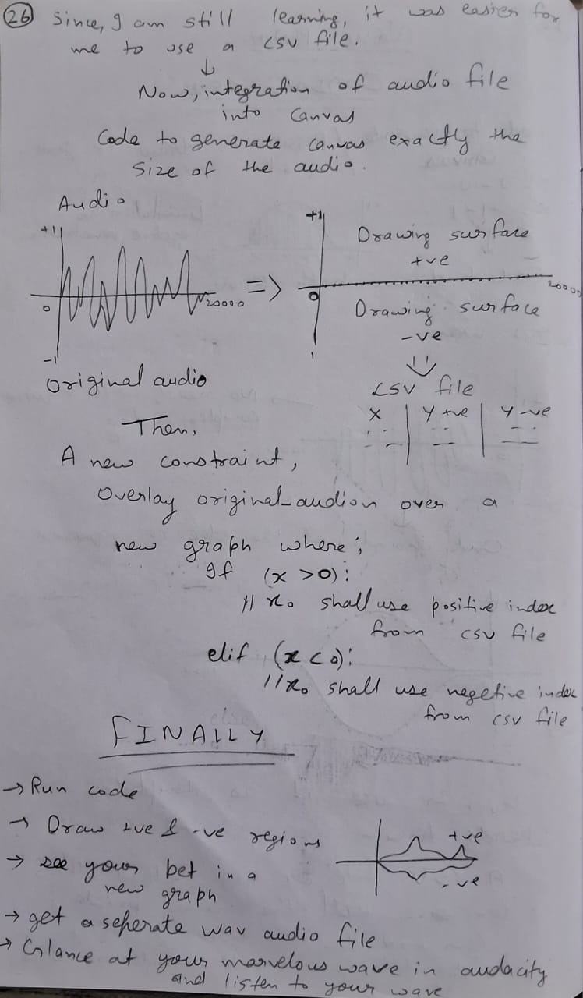
The PLAN

Slide 6
Plan to make ‘WOW’ signal a reality

Slide 7
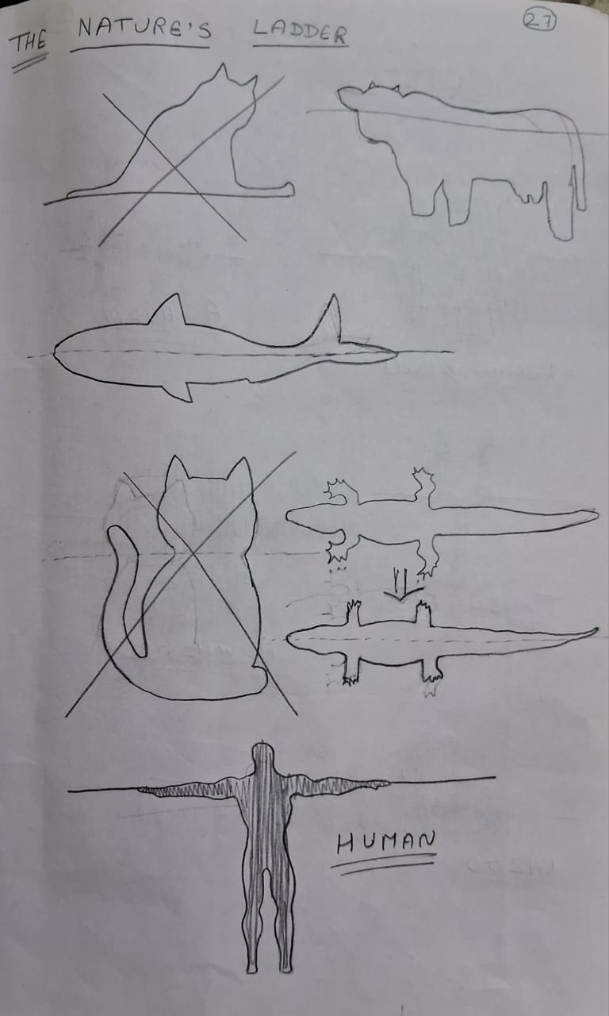
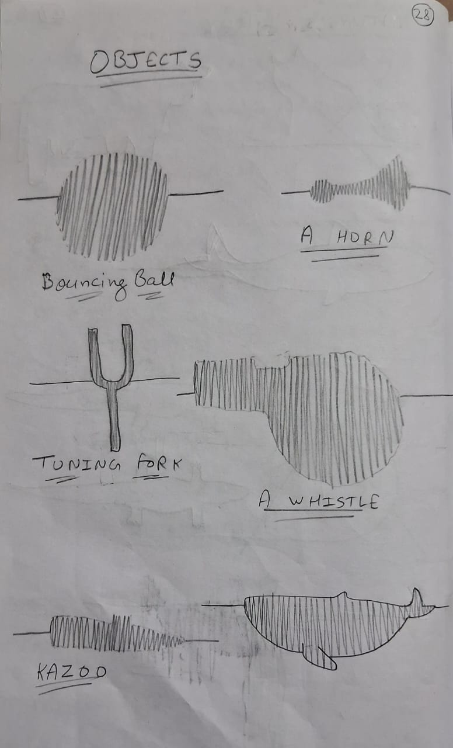
Possible shapes

Slide 8
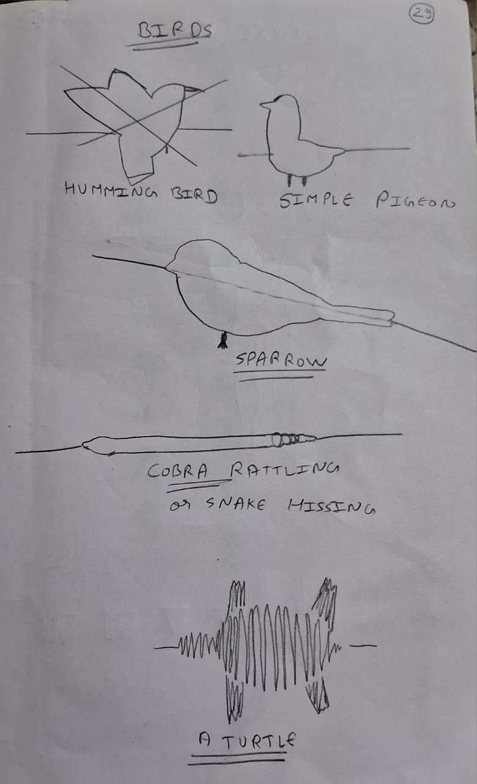
More shapes

Slide 9

Code implementation
Here’e my github link
https://github.com/World-hackr/Natural_Communication.git

Slide 10
Code Explanation
Run code.
Input an audio file (.wav) .
A canvas will pop-up, draw you desired shape.
Close the canvas window.
A file will be generated with following outputs:
1: a future_originalFile.wav. (modified audio)
2:a future_originalFile.png. (a plot comparison b/w original and modified wave)
3:a future_originalFile.csv. (+ve/-ve amplitude peaks)
4: a originalFile.wav. (original input audio file)

Slide 11
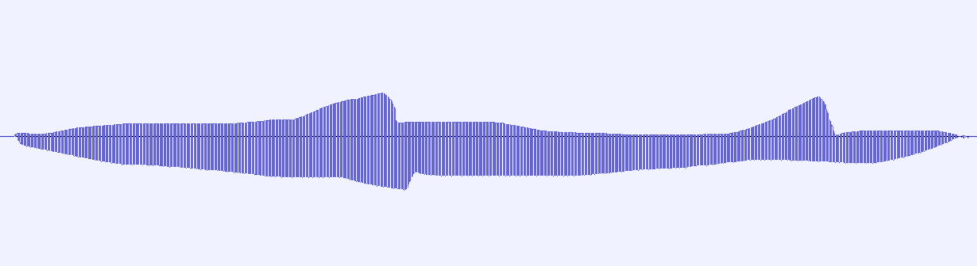

Characteristics of modified waves
Signals can sound exactly how they looks.
Have all the frequency modulated data, despite of modified amplitudes.
Any simple method to perceive those wave will result in looking like the user defined shape.
Due to For long distance travel waves might get elongated causing the defined to elongaed (due to red shift) as well, but by just compressing the time domain a bit, it can be fixed.
ELONGATED (red shifted) ORIGINAL(signal)

Slide 12
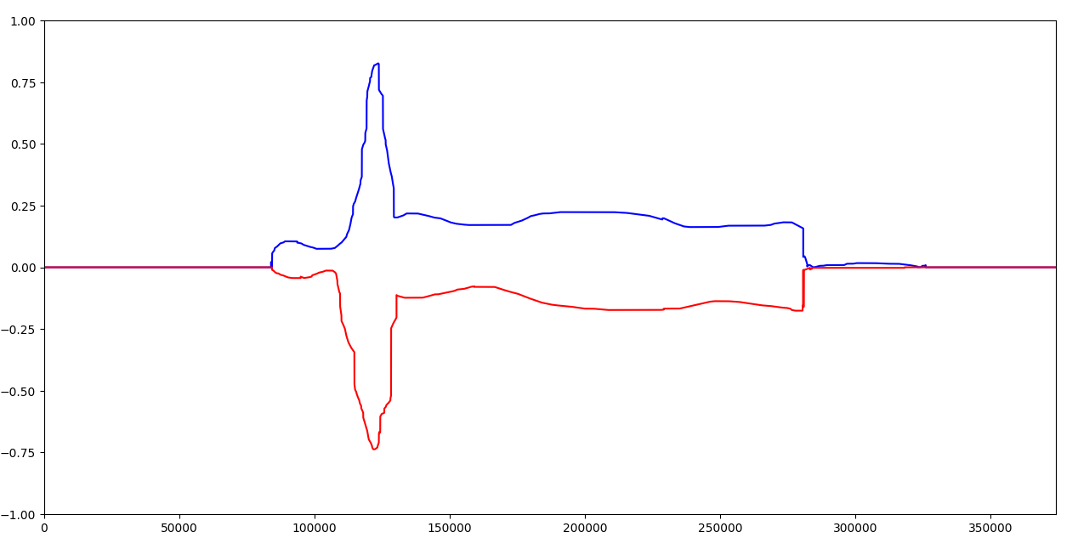
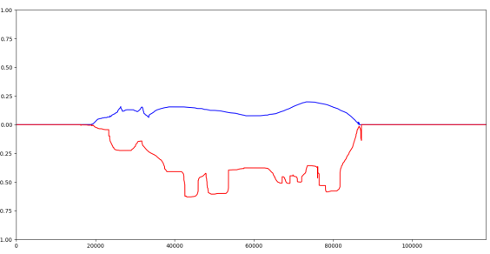
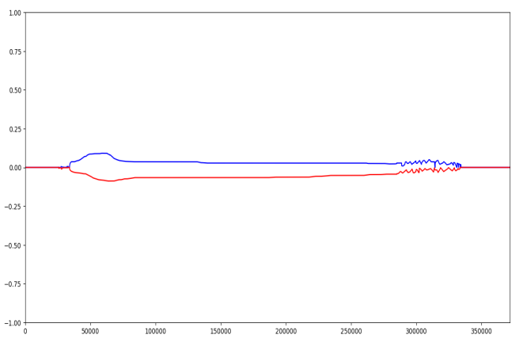
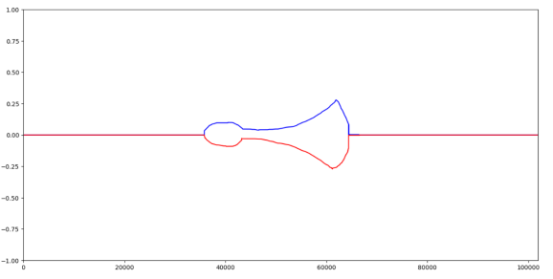
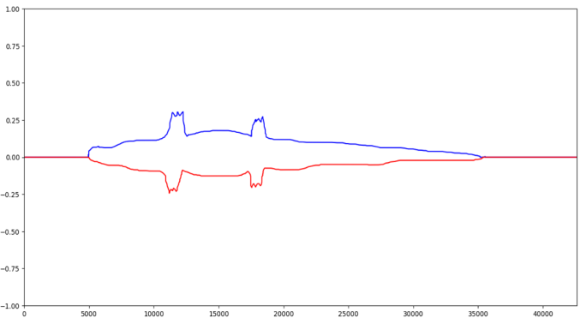
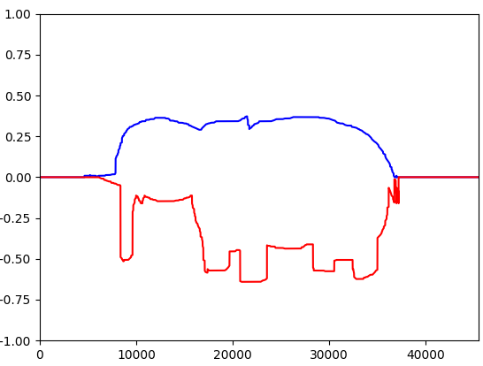
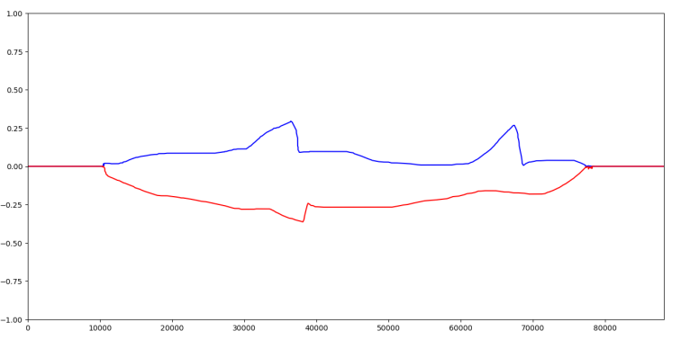
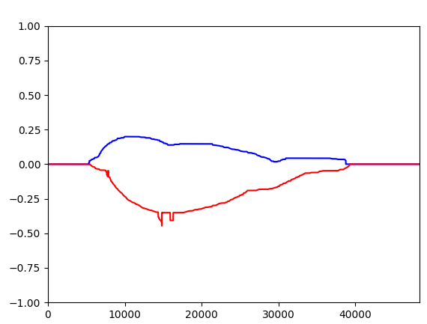
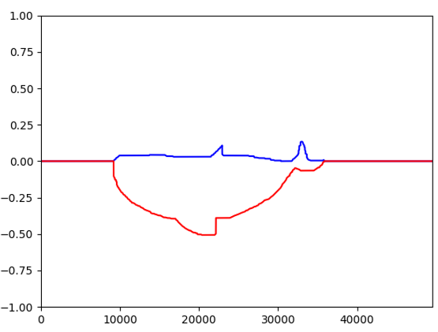
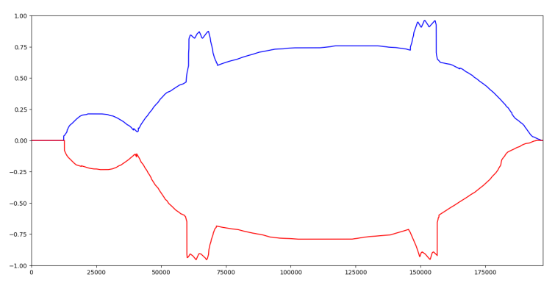
Some test examples

Slide 13
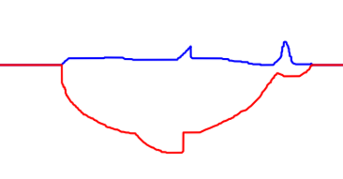
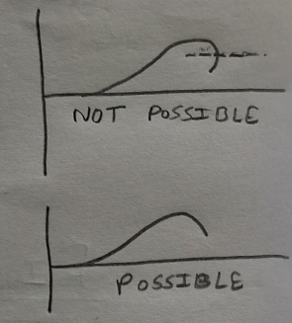
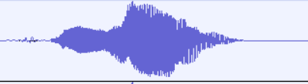

Current Limitations
Here
Only border line visible ( no details ).
No curves b/w number line and outer edge
Similar audio data but changed amplitude causing
harsh sound.
Very difficult to find the right persepective for the shape to be able to made with continuous sine waves.
Original (good sound)
Modified (bad sound)

Slide 14
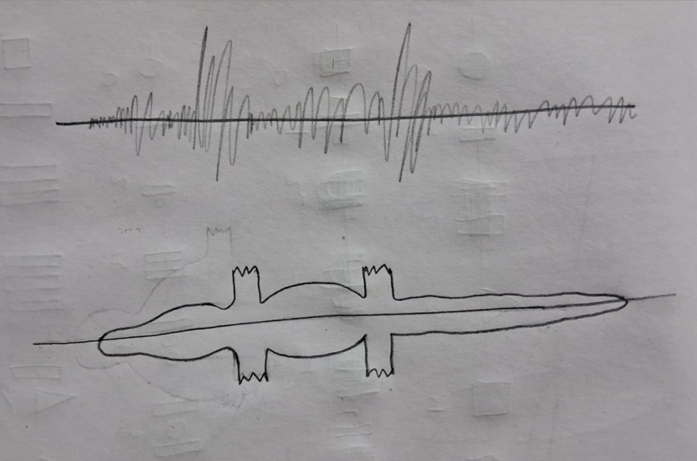
Future Plan
Training an ML model to generate images that can be possible to made using continuous sinewaves.
Improving wave modifier code so , it can understand the peaks of the wave and modify the wave according to the image so that , it would sound as similar to original sound as possible.
Optimized image and sound wave
unoptimized wave and imaegs

Slide 15
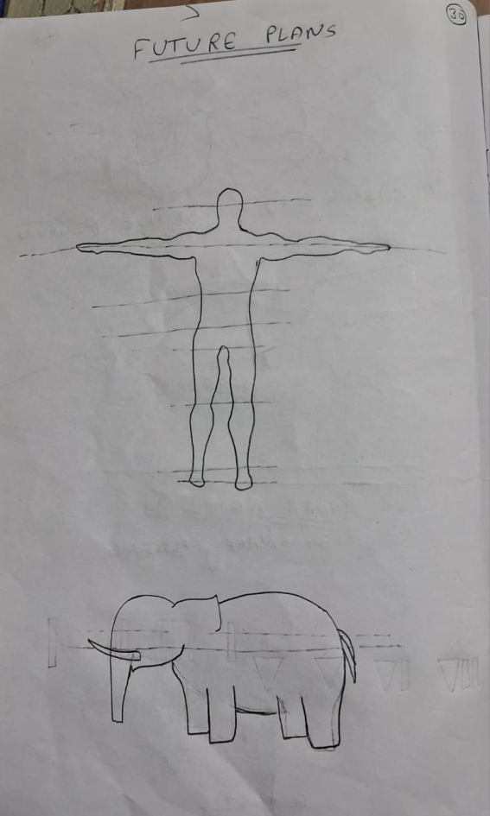
Advance encoding
By encoding a way to count the higher or lower numbers, it is possible to send a detailed image with eyes and facial features .

Slide 16
Working

